Slide 1

Graduation Rate for Top 5 Public Universities in Florida
Team Members: Cheikh Sidi El Moctar, Bridgette Sanders, Lisette Cruz, Ricardo Kenny

Slide 2

What affects the graduation rate within the top 5 Public Universities in
FLORIDA?
Factor Attributes:
Tuition & Fees
Acceptance Rate
Student Population
SAT Scores

Slide 3





Top 5 Public Universities
University of Florida
Florida State University
University of Central Florida
University of South Florida
Florida International University

Slide 4
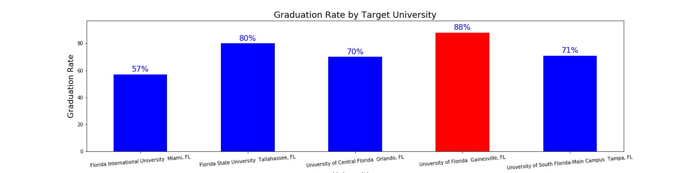
Graduation Rates %

Slide 5

Hypothesis
School size may affect graduation rates since smaller schools usually have a smaller student body; thus, smaller class sizes. This most often means more individualized attention for each student.
Universities requiring an above average ACT/SAT may have higher graduation rates as these are the students that are good test takers which will reflect in the classroom; thus, positively impacting graduation rate.
Universities with higher acceptance rates may translate to lower graduation rates as a higher acceptance rate may mean that the admission requirements are low.
Cost of Tuition will affect graduation rates since higher tuition costs may deter students from graduating to prevent further accumulation of debt.

Slide 6
Analysis Approach and Tools
Set Clear Measurement Priorities
Tools:
Pandas
Matplotlib
Scipy.stats
Seaborn
Data acquisition using scrapping using Pandas.
Data Cleaning, messaging, and visualization.
Analysis.
Finding Interpretation.
Conclusion & Recommandation

Slide 7
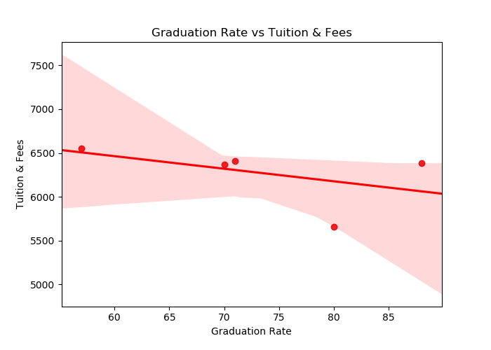
Tuition & Fees

Slide 8
Tuition & Fees Correlation

Slide 9
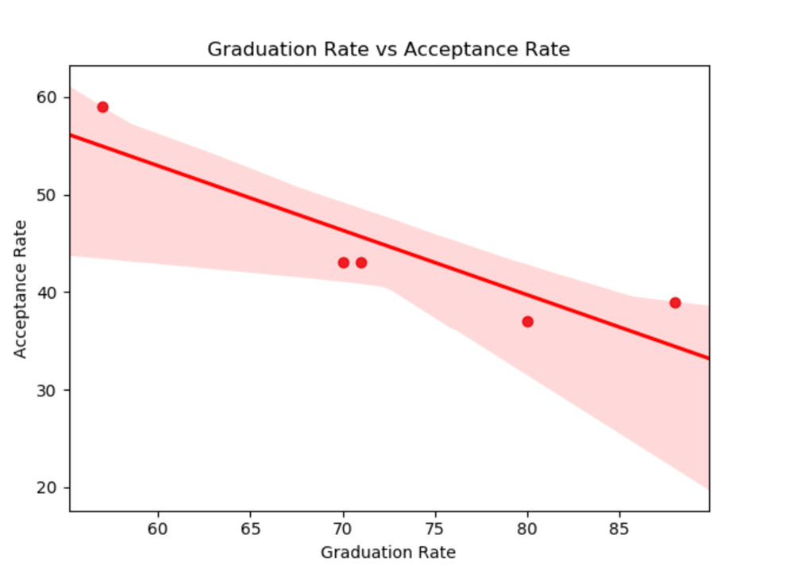
Acceptance Rate

Slide 10
Acceptance Rate Correlation

Slide 11
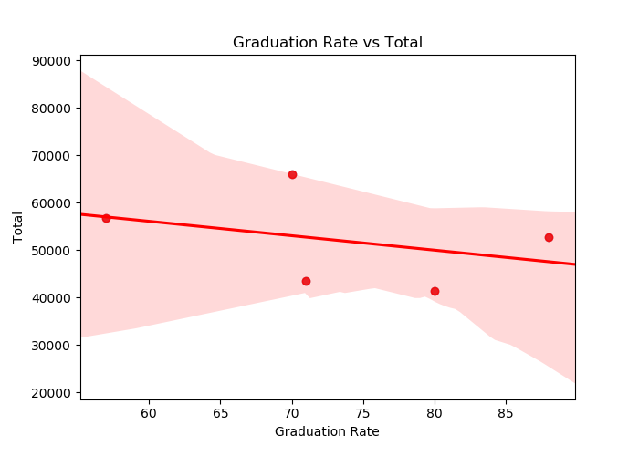
Total Student Population

Slide 12
Student Population Correlation

Slide 13
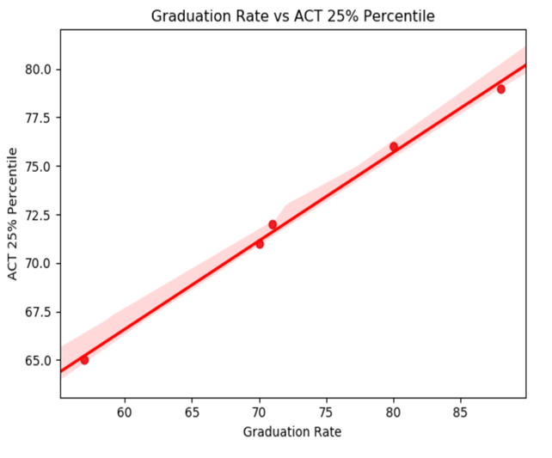
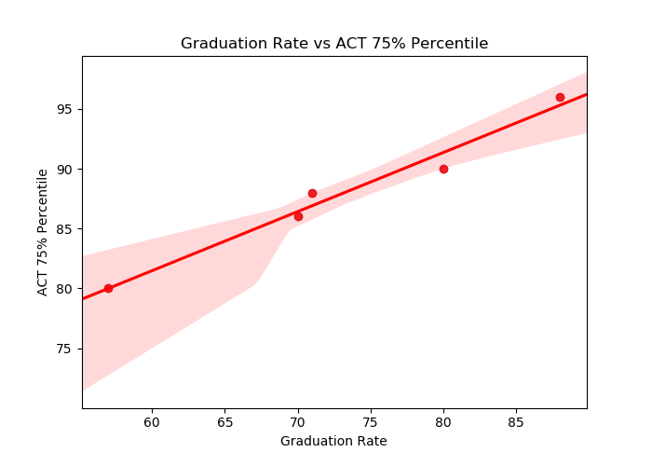
ACT Scores

Slide 14
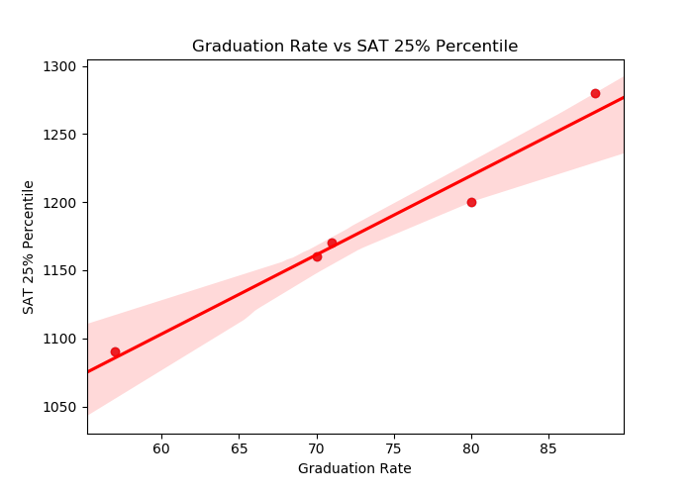
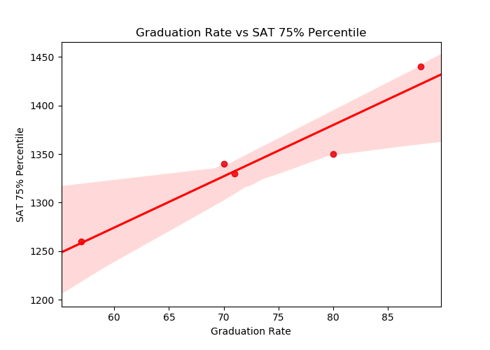
SAT Scores

Slide 15
ACT/SAT Correlation

Slide 16

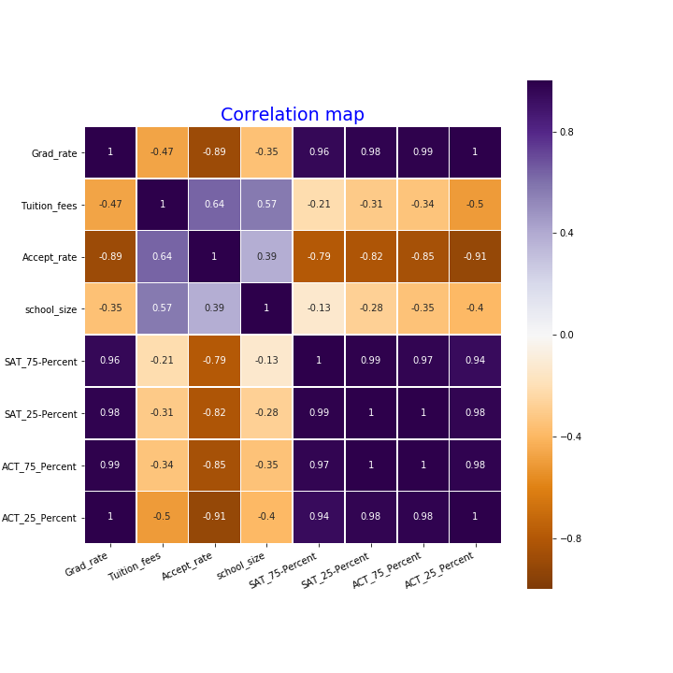
Give the data we have; we were not able to run t-test to test the Null Hypothesis.
On the right side a heatmap that correlate all the variables, the darker violet color the more positive correlation and the dark orange the more negative correlation.
Strong positive correlation between the SAT, ACT test scores and the graduation.
Strong negative correlation between Graduation Rate and Acceptance Rate.
Slight to low correlation between Graduation Rate and Tuition, School size.

Slide 17
SAT and College Success
The relationship isn't particularly strong, which means that if you have high SAT scores, you're only slightly more likely to have higher college grades than a student who had lower scores
In this sense, we can say that in general, higher standardized test scores do show a correlation with college success as it's usually defined. ... Whether a student does well on the SAT or ACT can be affected by a variety of factors aside from the student's inherent aptitude
AP and SAT scores can be one of the deciding factors in your college applications, or they could not matter at all. It really just depends on the college
SAT scores do predict college success - to an extent. The relationship isn't particularly strong, which means that if you have high SAT scores, you're only slightly more likely to have higher college grades than a student who had lower scores. Research shows a similar relationship between

Slide 18
College Admissions typical considerations
Consistent Solid scores on the SAT or ACT
Passionate involvement in a few activities, demonstrating leadership, initiative, impact--and an angle
Special talents or experiences that will contribute to an interesting, well-rounded student body
A well-written essay that provides insight into the student's personality, values, and goals
Anecdotal letters of recommendation from teachers and the student's counselor that give evidence of his or her intellectual curiosity, special skills, and positive character traits.
Demonstrated enthusiasm for attending a university, as evidenced by a campus visit, interview, and ongoing contact with the admission office.
Demonstrated intellectual curiosity through reading, school, and extracurricular pursuits, summer activities, and more

Slide 19
Summation: What affect the graduation rate within the top Universities in the Sunshine State of FLORIDA?
Our research on data provided by Federal education datasets shows:
Bla Bla Bla
Bla Bla Bla
Bla Bla Bla
Bla Bla Bla

Slide 20



